Slide 1


Tech Teach
Software Engineering Project
2025
Software Engineering Project
Prof /
Ibrahim Elawady

Slide 2


Tech Teach
Software Engineering Project
2025
Table Of Contents
Team Model
names for student work in this project
Project Vision
Long-term goal, direction, impact.
ERD
diagram representing entities
Ganta chart
visual project timeline showing tasks.

Slide 3

Tech Teach
Software Engineering Project
2025
Team Model

Slide 4

Tech Teach
Software Engineering Project
2025
Team led by
Prof/Ibrahim Elawady
Names Seat number
Mohamed amin hassan 2072022140
Sherif Talaat Fawzy Yanni 2072022077
Sayed Mostafa Attia Ahmed 2072022071
Ahmed Mostafa Mohamed 2072022025
Ahmed Hassan Mahmoud 2072022007

Slide 5

Tech Teach
Software Engineering Project
2025
Project Vision

Slide 6

Tech Teach
Software Engineering Project
2025
“ FOR teachers, administrators, and students in underserved communities,WHOstruggle to access high-quality educational resources and opportunities ,THE Tech Teach is a non-profit organization,THAT provides free educational materials, technology, and professional development to bridge the digital divide and enhance learning outcomes,UNLIKE traditional educational non-profits ,OUR PRODUCT focuses on leveraging technology to create personalized and engaging learning experiences for all students. ”

Slide 7
Company Name
Tech Teach
Software Engineering Project
2025
ERD

Slide 8
Company Name
Tech Teach
2024
Software Engineering Project
2025
ERD
An Entity-Relationship Diagram (ERD) is a visual tool used to model the structure of a database, showing entities, their attributes, and relationships. It helps in designing and organizing data within a system.

Slide 9
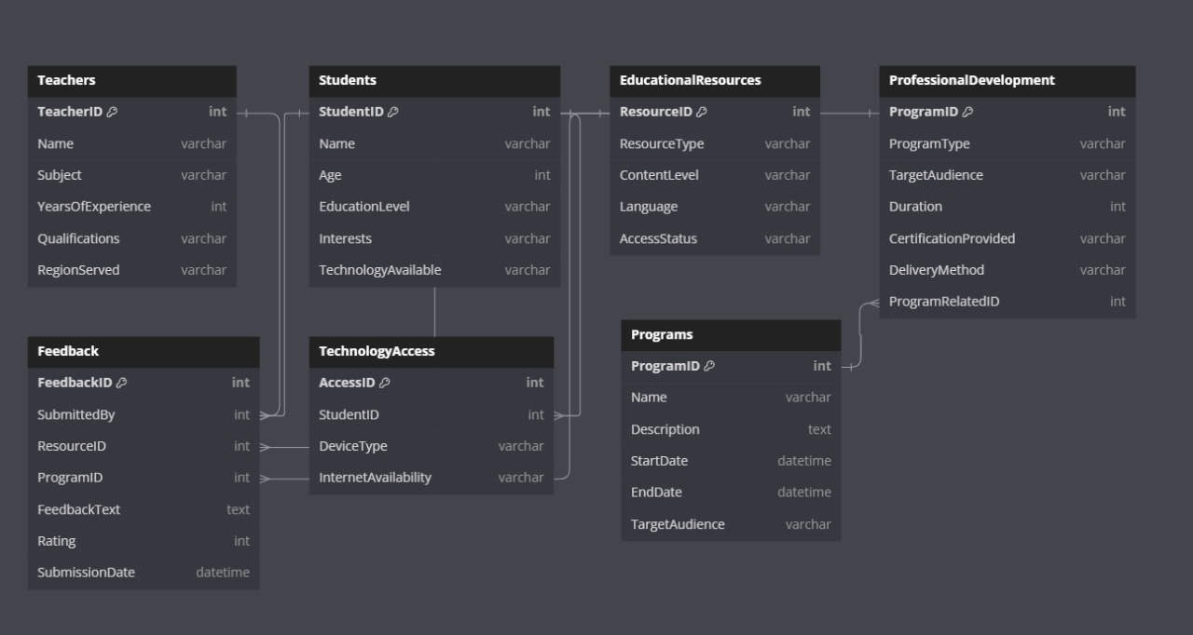
Tech Teach
Software Engineering Project
2025

Slide 10

Company Name
Tech Teach
Software Engineering Project
2024
2025
DFD

Slide 11

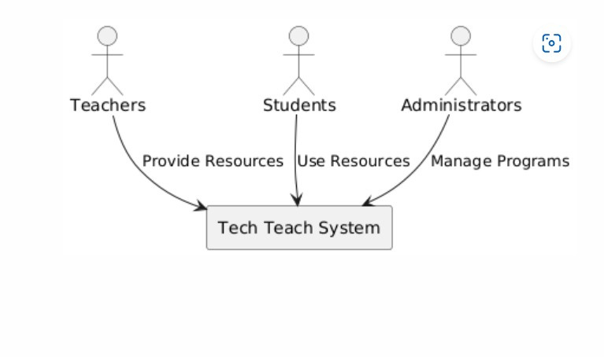
Company Name
Tech Teach
Software Engineering Project
2024
2025
DFD LEVEL 0

Slide 12
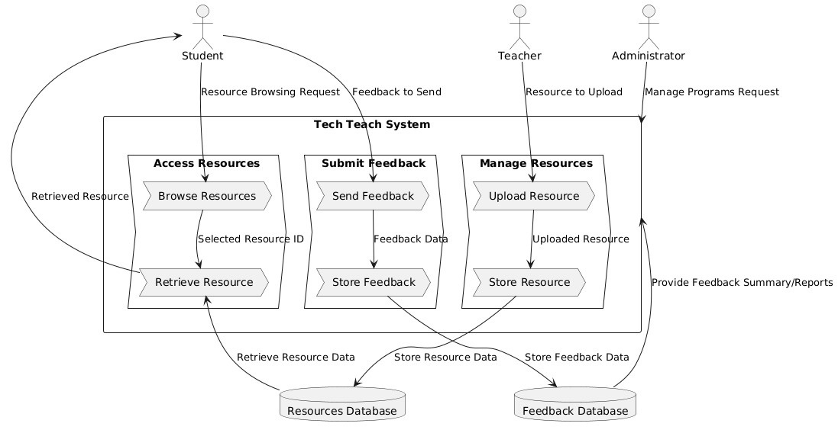
Company Name
Tech Teach
Software Engineering Project
2024
DFD LEVEL 1
2025

Slide 13
Company Name
Tech Teach
Software Engineering Project
2024
2025
manage Resources
DFD LEVEL
2
Submit Feedback
Access Resources

Slide 14
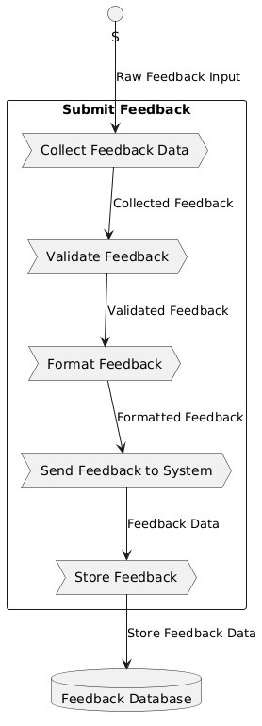
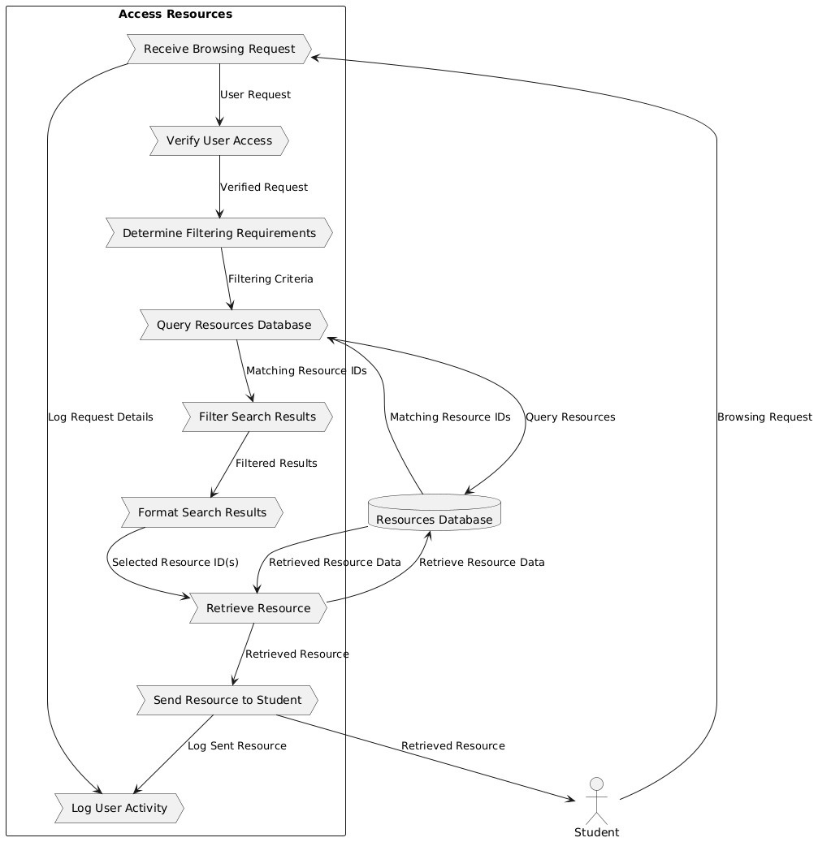
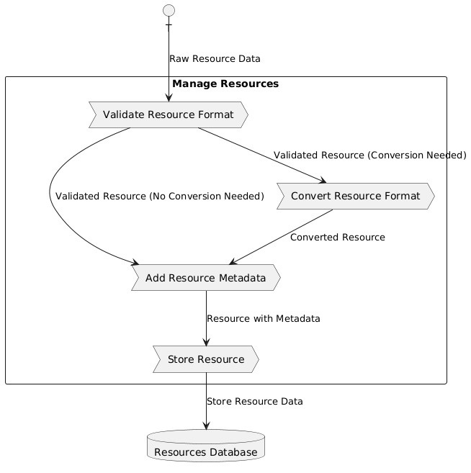
Company Name
Tech Teach
Software Engineering Project
2024
2025

Slide 15
Company Name
Tech Teach
Software Engineering Project
2024
2025
Gantt Chart

Slide 16

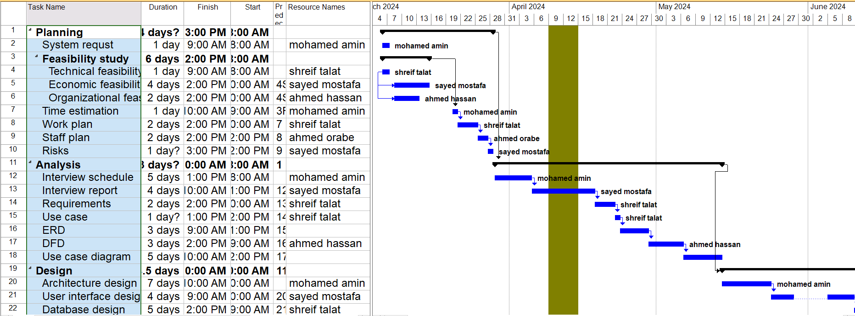
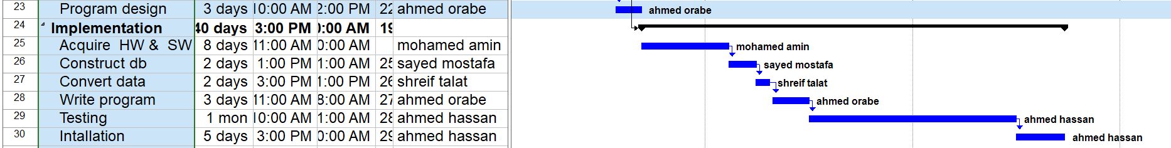
Company Name
Tech Teach
Software Engineering Project
2024
2025

Slide 17
Company Name
Tech Teach
Software Engineering Project
2024
2025
Interface

Slide 18
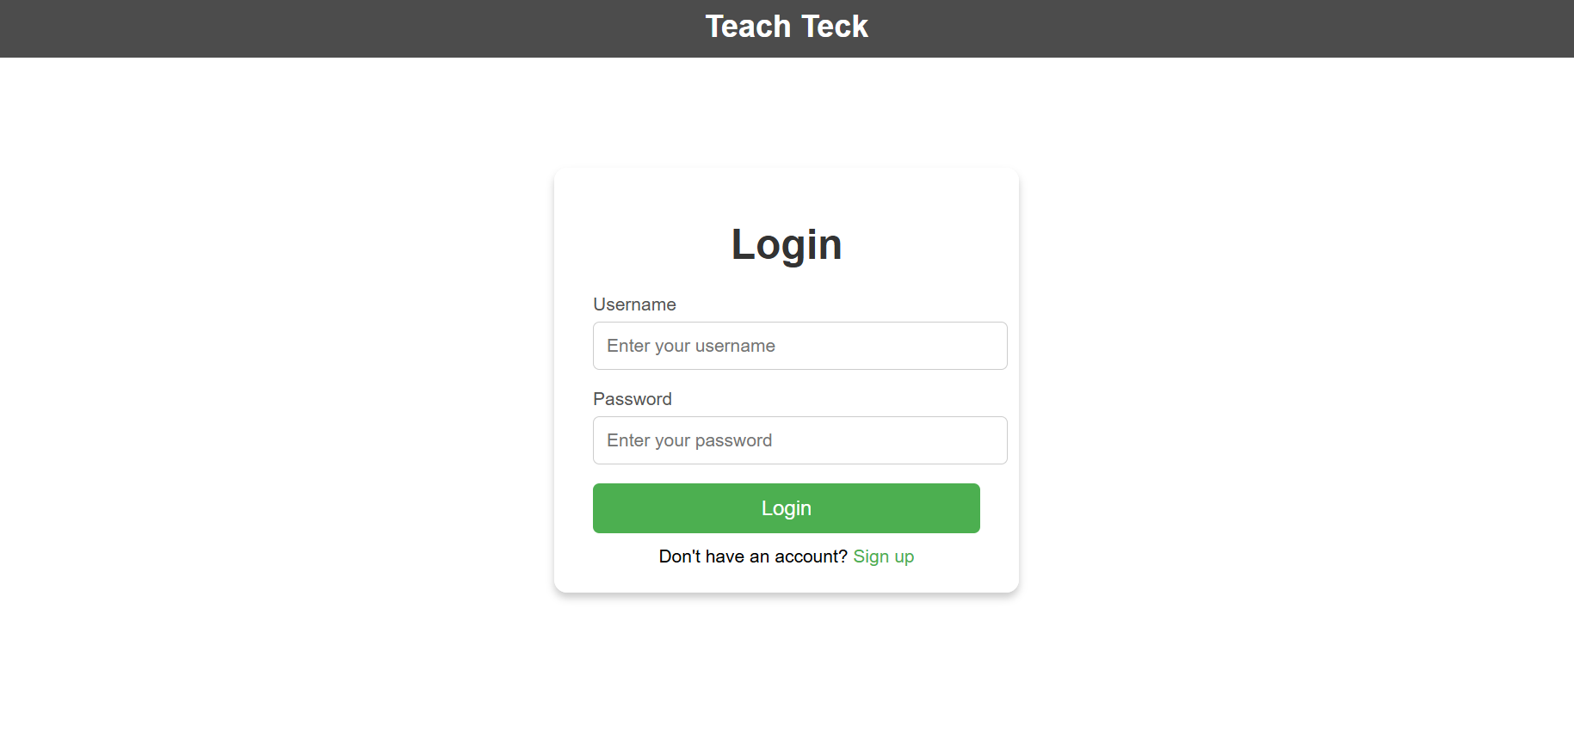
Company Name
Tech Teach
Software Engineering Project
2024
2025

Slide 19
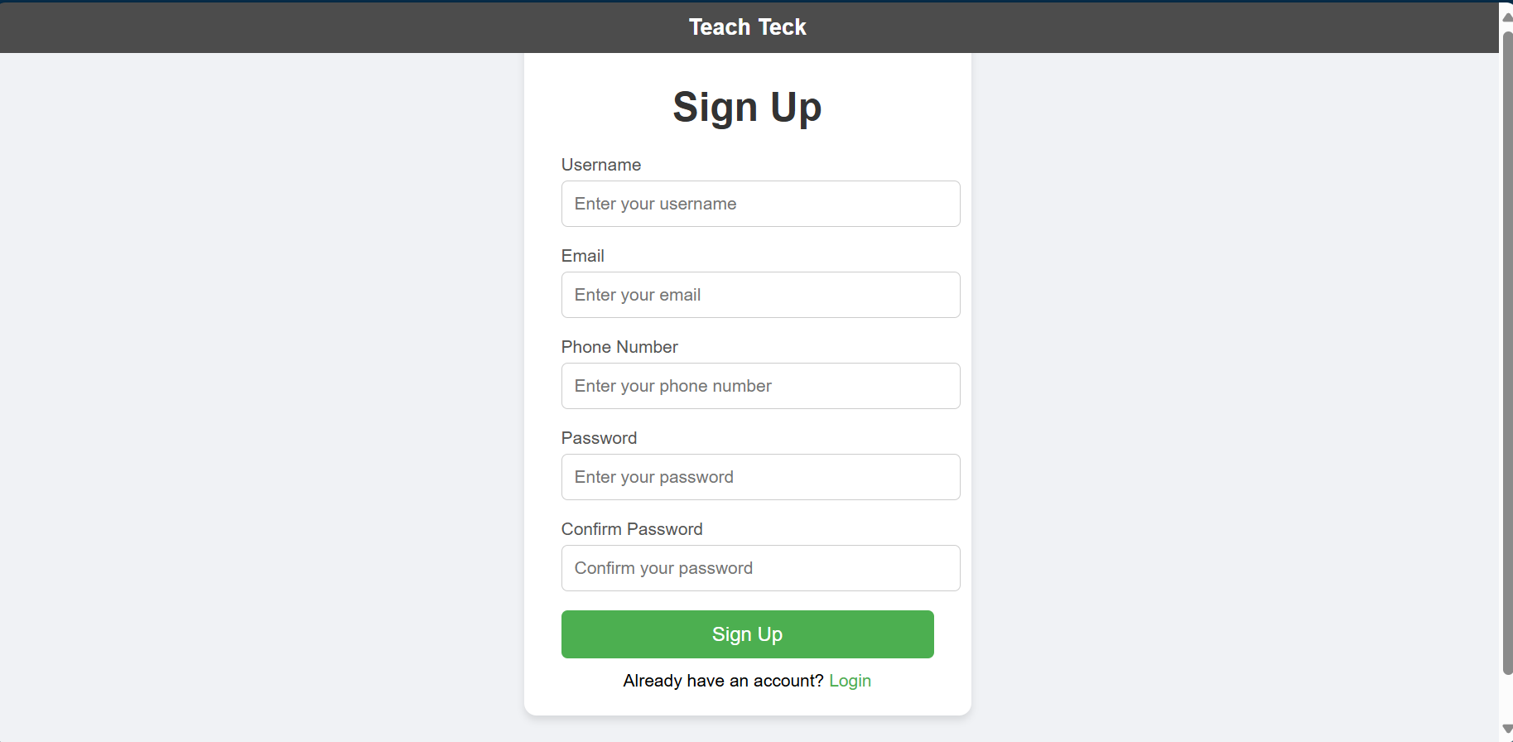
Company Name
Tech Teach
Software Engineering Project
2024
2025

Slide 20
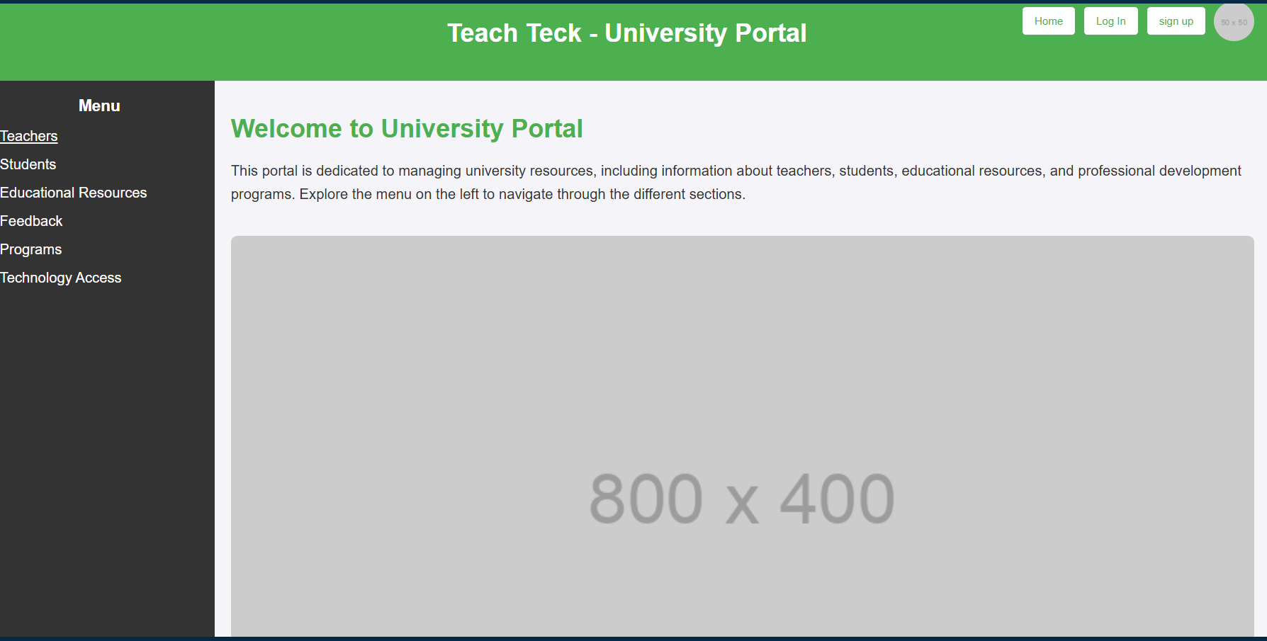
Company Name
Tech Teach
Software Engineering Project
2024
2025

Slide 21
Thank you For watch

